Slide 1

Blood Bank Management System
Group Members
Ali Aftab
Dua Namdeem
HussNain Arshad

Slide 2
Introduction
The blood bank system can collect blood from many donors in short from various sources and distribute that blood to needy people who require blood.
Bank login your account via correct id and password and blood bank register donor’s account if donor does not exist before and also go towards dashboard after registration if donor exists.
Blood bank searches the existing donor via different filters.
Blood bank check the stock details like how many total number of bags exist with blood groups.
Blood bank have different types of contact methods like via website, email and telephone, the most popular method in our country.

Slide 3
Introduction
Other functions of our project are acceptor and donor feedback.
It helps the system to improve its services. In short this section is for user experience.
There are also blood camp details. Camp organized by the blood bank in different areas in different times. Time and location are pre uploaded on the application . and also the details are shared with current user via email and text messages.
In the blood bank, volunteers donate blood and bank also buys blood. Bank buys only rare blood groups. At the end there are the payment methods of buying and selling the blood.

Slide 4
Background
To provide an efficient donor and blood stock management system to the blood bank by recording the donor and blood details.
To provide pure blood with no wastage blood is been collected in different types of packs.
To provide immediate storage and retrieval of data and information.

Slide 5
Limitations
No work in Pakistan.
Limited location .

Slide 6
Project Scope
Blood bank login
Register donor
Search donner
Stock details
Contact us
View inquiry
Camp details
Buy blood.

Slide 7
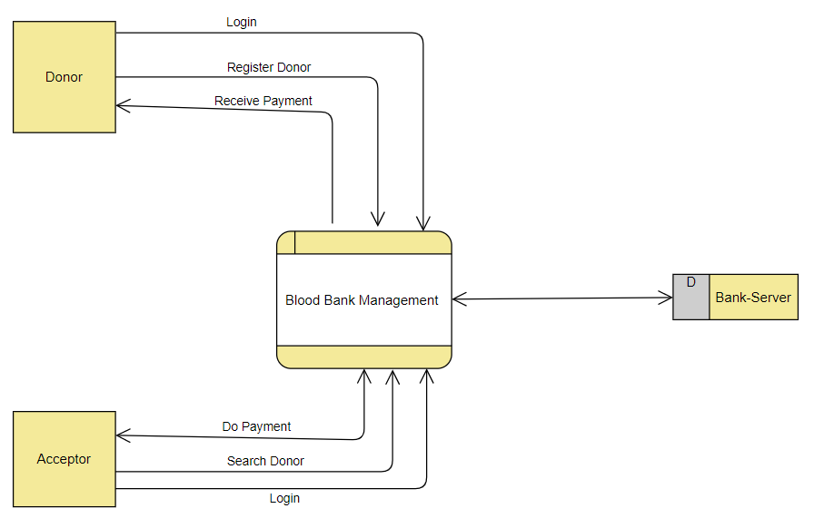
Data Flow Diagram (DFD) Level 0

Slide 8
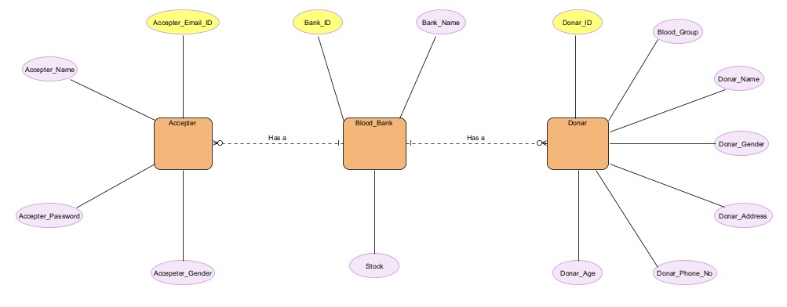
Entity relation diagram

Slide 9
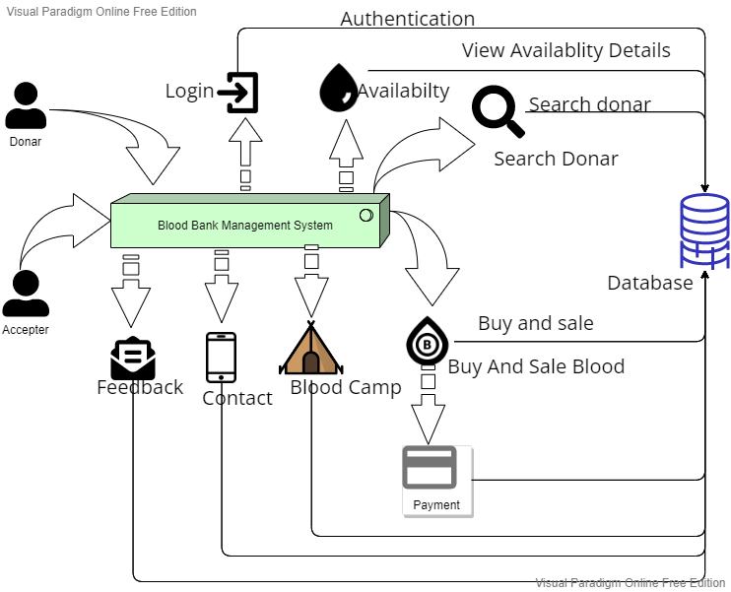
Architecture

Slide 10
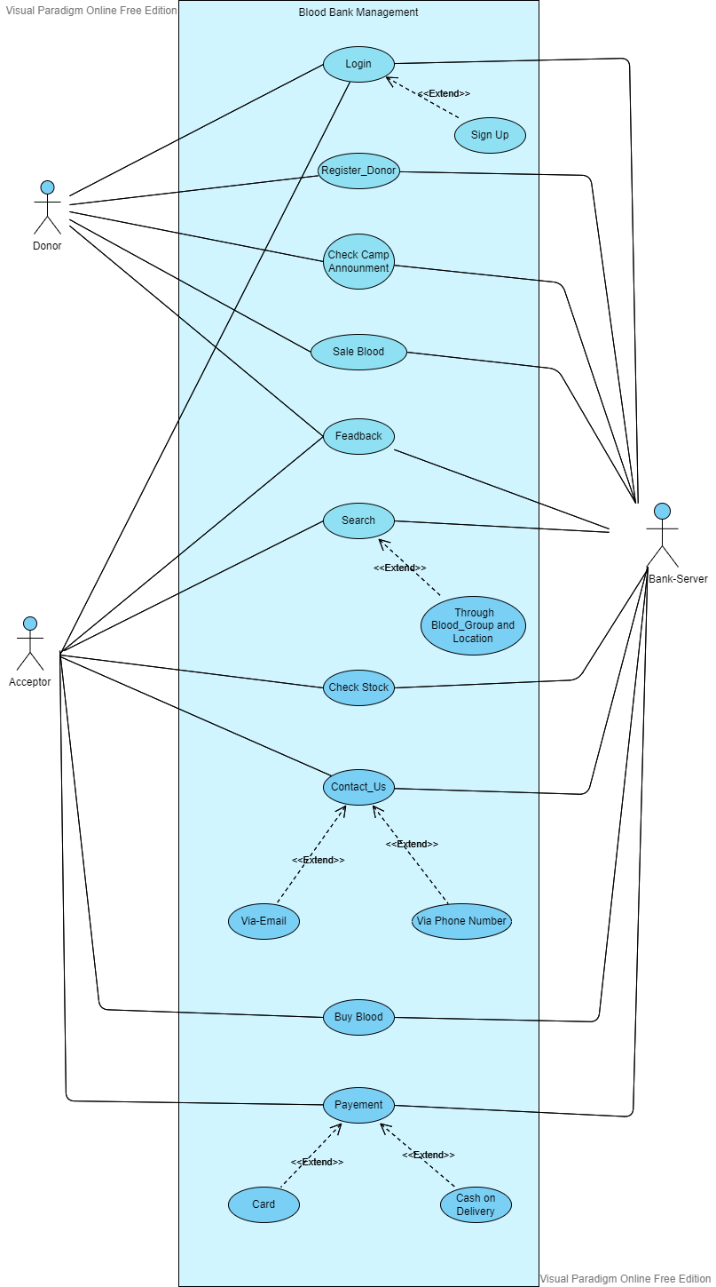
Use Case Diagram

Slide 11
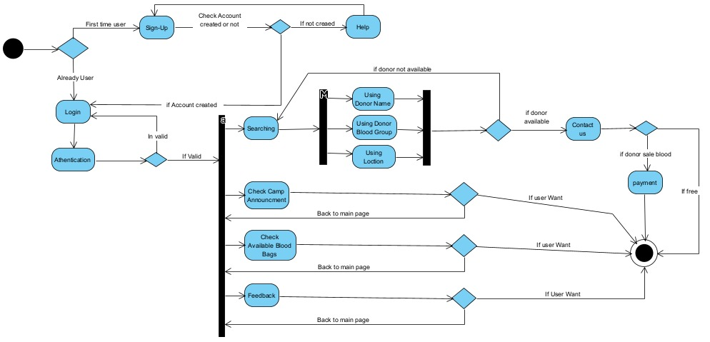
Activity Diagram:

Slide 12
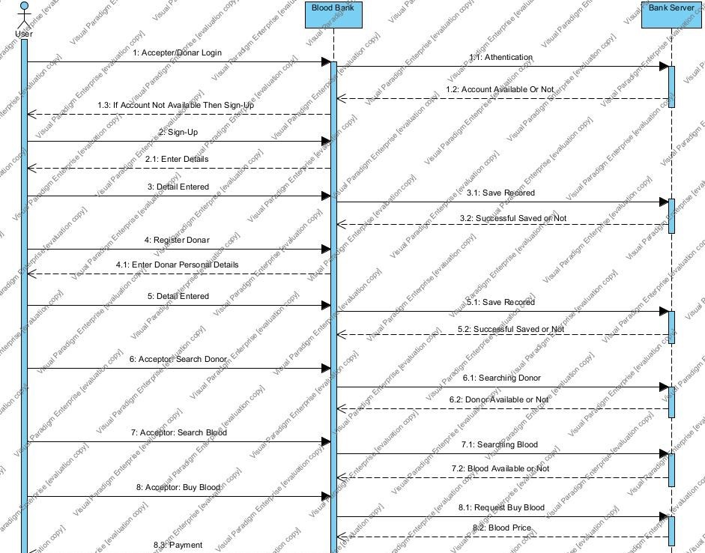
Sequence diagram First half

Slide 13
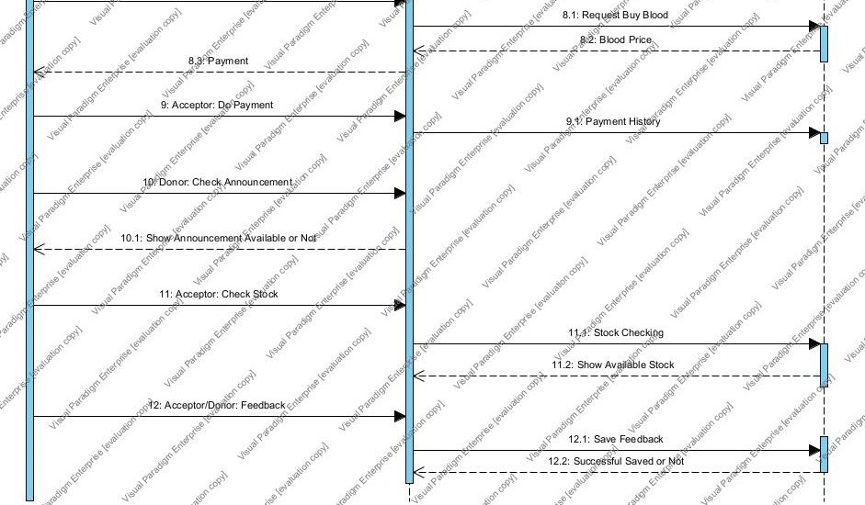
Sequence diagram Second half

Slide 14
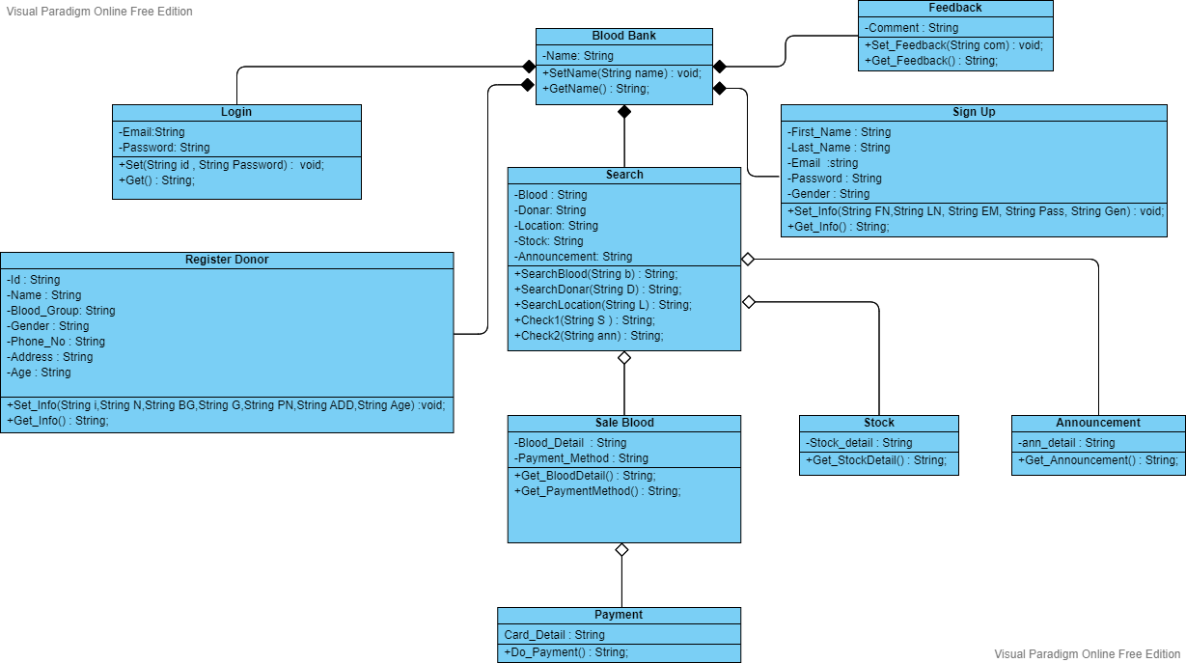
Class Diagram:

Slide 15
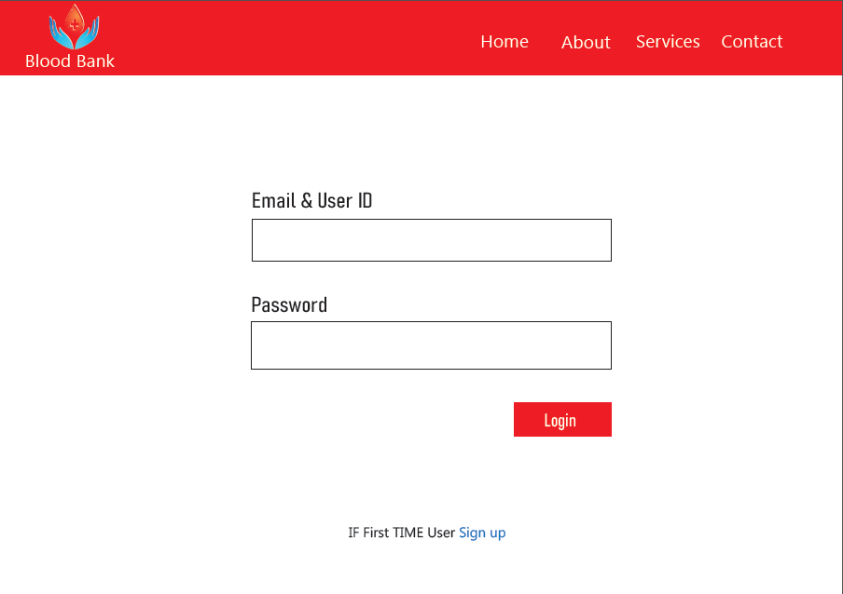
Prototypes Login

Slide 16
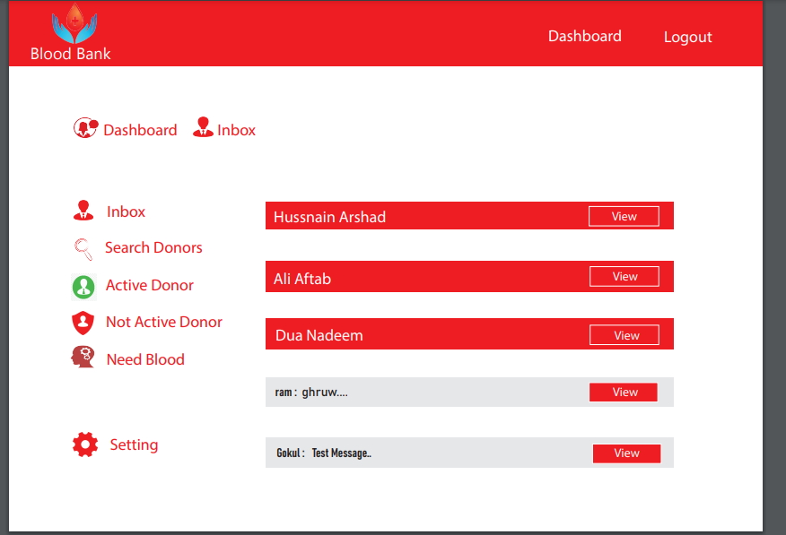
Prototypes dashboard

Slide 17
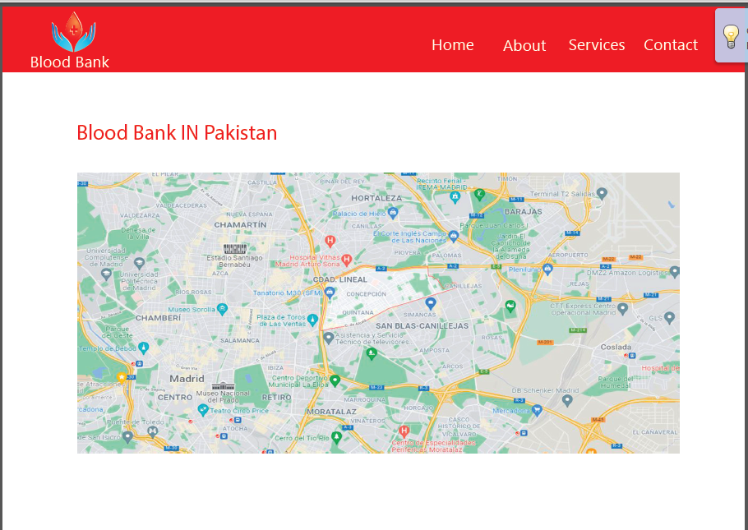
prototype Location

Slide 18
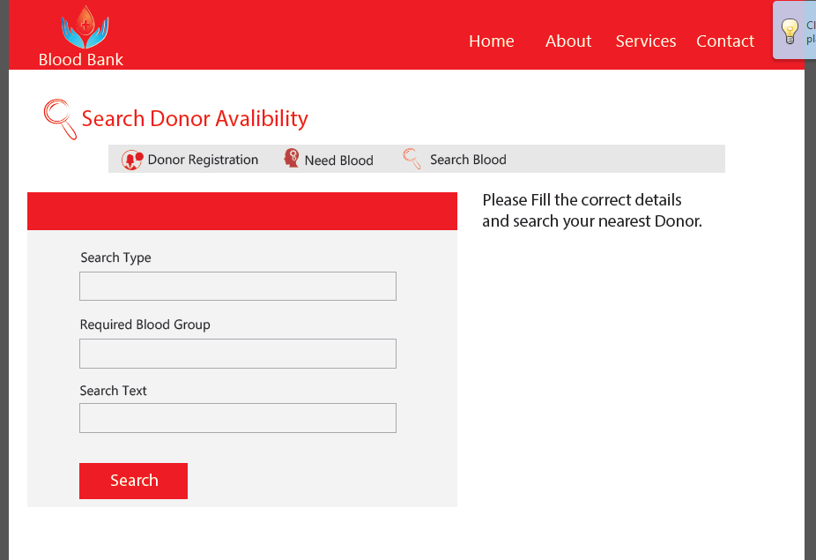
Prototype search

Slide 19
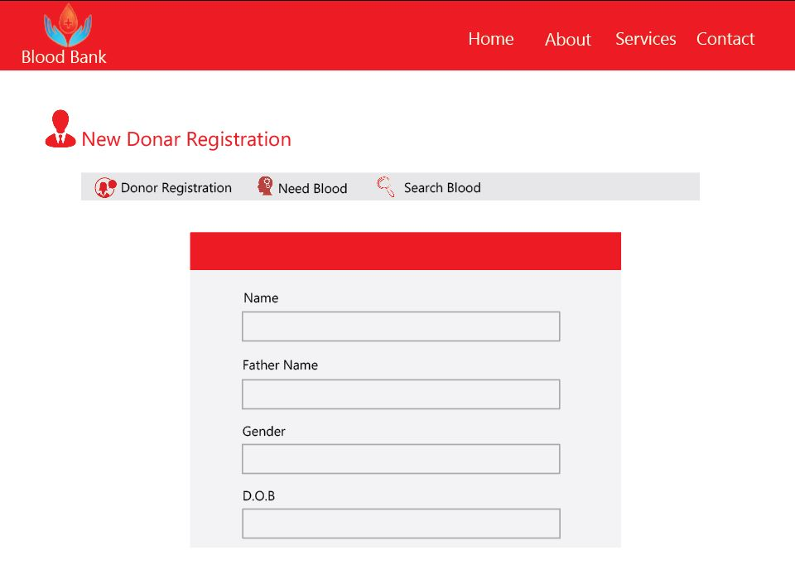
Prototype Registration

Slide 20
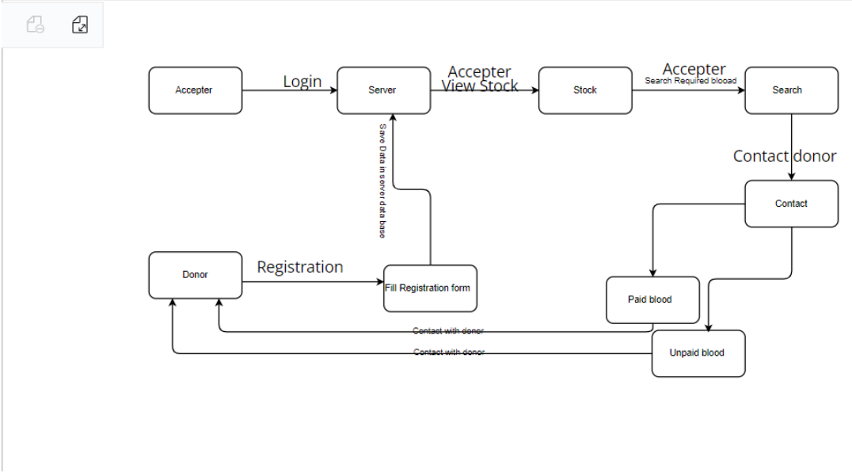
Collaboration diagram:
login

Slide 21
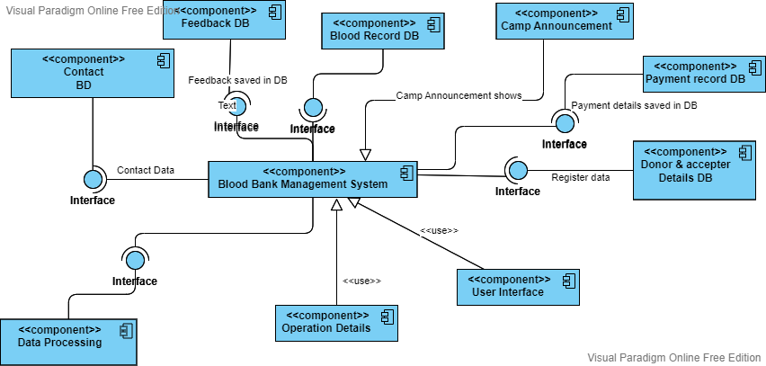
Component diagram

Slide 22
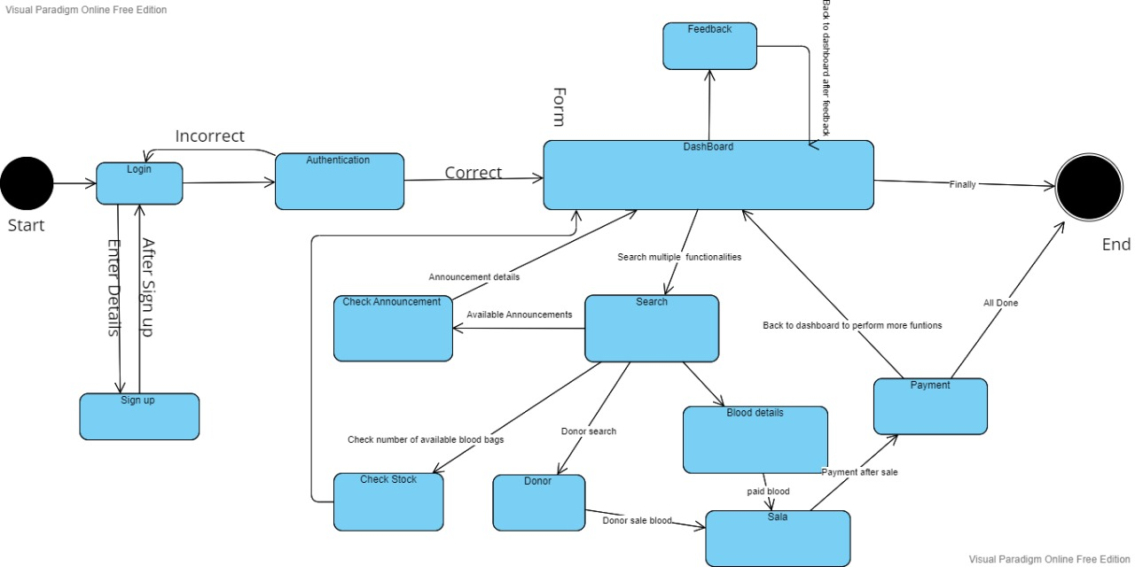
State Machine diagram

Slide 23
Future work
Our future work would be to integrate this blood bank management system with other health care provider centers, hospitals and blood banks. We will add new features as well and when required. And improving its effectiveness as well.

Slide 24
Any Question

Slide 25
Thank you

